Slide 1
CST-235 Computer Programming III
Topic 2 (4 weeks)

Slide 2
Lectures for Topic 2
Lectures:
Presentation Layer:
Servlets and JSP Pages => Week 1
MVC Design Pattern => Week 2
JavaServer Faces => Week 2
Data Validation and Layouts => Week 3
Data Grid Control => Week 4
Hands On:
Build a simple Java Servlet and JSP based application.
Build a simple JSF form based application.
Add data validation and layouts
Add a data grid

Slide 3
Lectures for Topic 2 – Week 1
Lectures:
Topic 2 Project Assignment Requirements.
Presentation Layer:
Java Servlets
JavaServer Pages
Hands On:
Build a simple Java Servlet and JSP based application.

Slide 4
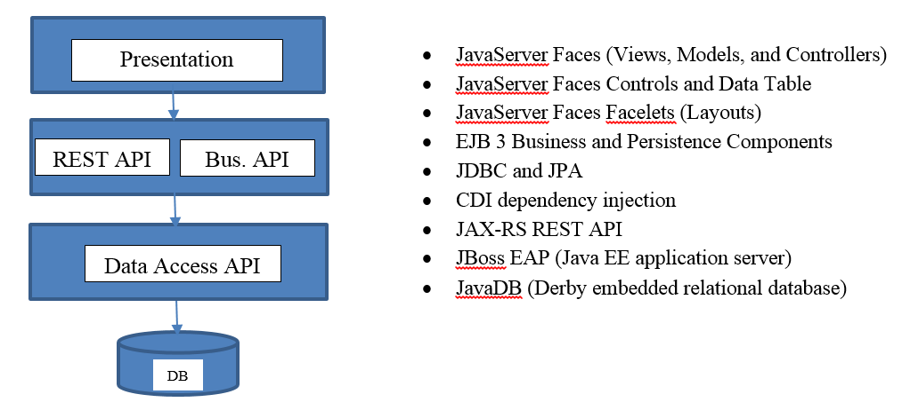
Project Overview
In this class you will design and build a complete enterprise class N-Layer application using Enterprise Java technologies, that meets a certain set of functional and technical requirements, and as shown in the figure below.
The Class Project has changed!

Slide 5
Review Topic 2 Assignment Requirements
Please pull up the Assignment #2 from the Announcement
Review the Requirements
The Class Project has changed. Please pull up the Project Requirements from the Assignment.

Slide 6
Introduction to Enterprise Java Presentation Layer

Slide 7
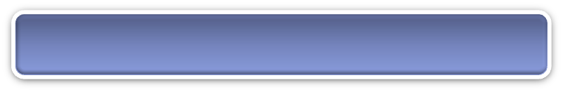
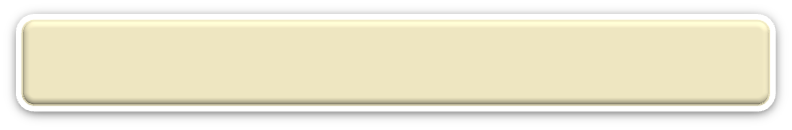
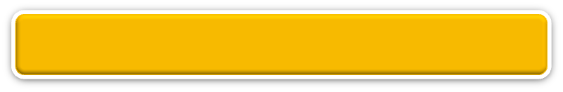
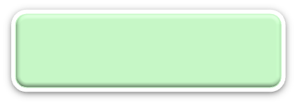
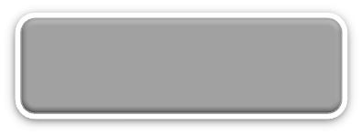
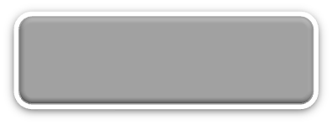
N-Layer Architecture
This layer is all about handling requests and events from the client, dynamic user interface generation, and data presentation
RIA Design
Client Layer (Desktop/Mobile/Browser)
User Interface, (Minimal) Client Side Validation, AJAX, UI Rules
AJAX
jQuery
CSS
Forms
HTTP/HTTPS POST
Event Based Design
Presentation Layer (PL)
User Interface, UI Event Handlers, UI Rules, Navigation
JSF
Data Validators
Canonical Object Model
Local POJO, SOAP, REST
Design By Contract
Business/Services Layer (BLL)
Business Logic, Business Rules, Workflow, Data Validation
EJB
IoC/CDI
JAX-WS and JAX-RS
Canonical Object Model
Canonical Object Model
Optional SOAP, REST
SOAP, REST
Entity Driven Design
Data Access/Services Layer (DAL)
CRUD Data Persistence
Integration Tier
Orchestration
(Workflow*, Rules*)
Entity Beans (ORM)
Hibernate
Data Access Objects
Data Model
JMS, SOAP, .JAXB, Spring
Cache
Operational
Database
External Systems
Interfaces, Feeds, Printers
Business Entity
Media

Slide 8
Java Servlets and Java Server Pages (JSP)

Slide 9
What is a Web Server?
Unlike desktop applications, which are run from a local computer, web applications require a Web Server to host and serve up the application and require a web browser to render the application and interact with the user of the application.
Web applications are made up of a collection of static files (such as *.html, *.css, *.js, *.jpg) and dynamic files (such as *.jsp, *.xml, *.json) hosted on the Web Server.
The Web Server responds to HTTP requests and sends back HTTP responses.
Examples: Apache, Microsoft IIS, IBM WebSphere

Slide 10
What is JBoss EAP?
JBoss EAP (Enterprise Application Platform) is a full Java EE compliant application server.
Remember Java EE is a specification and not a product.
JBoss EAP is engineered, supported, and distributed by Redhat.
JBoss EAP is not only a Java EE application server but also has an Apache Web Server built into the product.

Slide 11
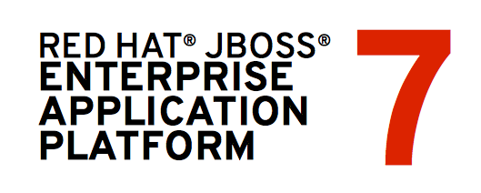




How does JBoss EAP work?
Client
Server
Internet
Step 2a: If the request is for a MIME type the Web Server can process (extension of HTML, JS, JPG/PNG, etc.) the Apache Web Server will serve that request.
Step 1: The browser sends a request to the Apache Web Server for processing.
Request
Response
Step 3: The browser will render the response send back from the Apache Web Server (or content created by the PHP Engine).
Step 2b: Else if the request is for a MIME type JBoss can process (JSP or Servlet) then JBoss will serve that request. All JSP’s, Servlets, and other Java code are executed in the JVM.

Slide 12
What is a Java Servlet?
A Servlet is an object that receives an HTTP request and generates an HTTP response based on that request.
A Servlet is the lowest level of a Java Component that can handle network requests besides a Java Socket.
A Servlet can only support the HTTP protocol.
A Servlet is mapped to a URI. Any HTTP requests made to that URI are then handled by the Servlet.
A Servlet when invoked follows a life cycle defined by the Enterprise Java Specification: init->service->destroy
A Servlet has methods that you can override to execute code within the life cycle phase.

Slide 13
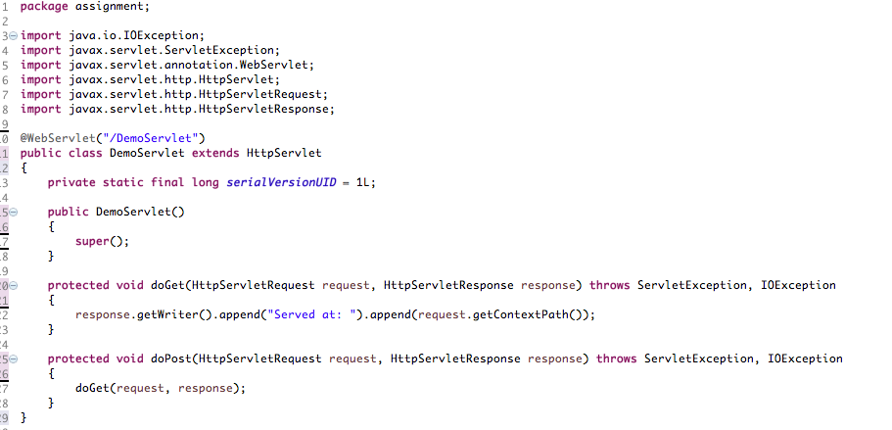
Can I see an example Java Servlet?
hostname:port/appname/DemoServlet
URI for this Servlet
Handles HTTP GET for this URI
Handles HTTP POST for this URI

Slide 14
In-Class Activity
Code a Java Servlet!
Start the In-Class Activity #2a that I posted in an Announcement.
Implement a simple Java Servlet.
Override the init() and destroy() methods.
Leave the default implementation of doGet().
Print test messages for the init(), doGet(), and destroy() methods.
Test in your browser.
Take screen shot.

Slide 15
End of Class

Slide 16
Discussion – What is a Servlet?
What is a Java Servlet?
What are the life cycle phases of a Java Servlet?
What method gets called for a HTTP GET request?
What method gets called for a HTTP POST request?

Slide 17
Is a Java Servlet Thread Safe?
Each Servlet request is distinct from the next Servlet request.
The init() is called the FIRST time the Servlet is loaded into memory.
The destroy() is called whenever the Servlet Container decides to remove the Servlet from memory and this is specific to each application server.
Multiple requests may even be handled by the same Servlet instance!
Bottom line…………a Servlet by default is simply not thread safe!
What does this mean?
Multiple requests may be handled by the same Servlet instance so don’t declare or use class scoped variables.
Multiple requests may be handled by the same Servlet instance so don’t declare static variables at the class or method level.

Slide 18
How can I pass data to a Java Servlet?
HTTP GET and HTTP POST:
The first parameter to doGet() and doPost() is of type HttpServletRequest.
The HttpServletRequest class has a method getParameter(“attribute”).
Example for HTTP Get:
localhost:8080/assignment2a/TestServlet?firstname=“Mark”&lastname=“lastname”
String firstName = request.getParameter(“firstname”);
String lastName = request.getParameter(“lastname”);
Local JBoss
App Name
Servlet URI
HTTP GET Parameters
Why do you have to be careful when using an HTTP GET?

Slide 19
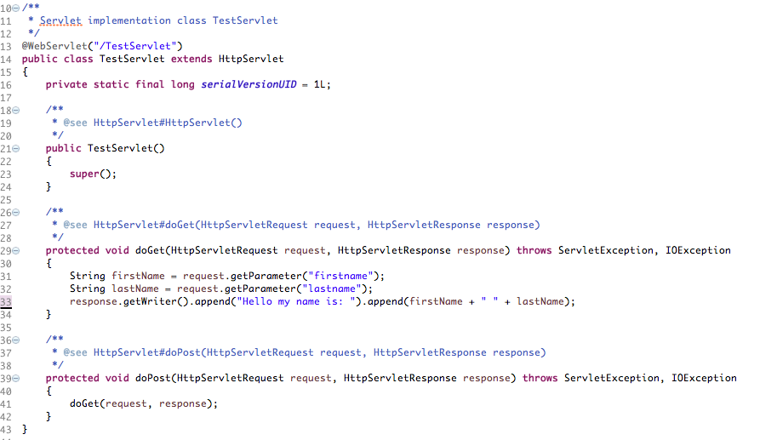
Can I see an example Java Servlet?
hostname:port/appname/TestServlet?firstname=Mark&lastname=Reha
Read params

Slide 20
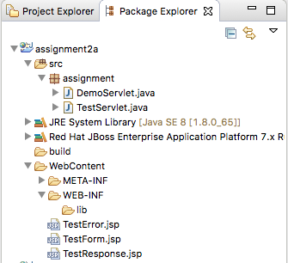
How is a Dynamic Web Project Laid Out?
All Java code separated logically by packages.
web.xml
For most of your application code you can use annotations versus XML configuration
STANDARD directory were web.xml and other configuration files go.
Where dependent library JAR files go.

Slide 21
In-Class Activity
Code a Java Servlet!
Finish the In-Class Activity #2a that I posted in an Announcement.
Update the default implementation of doGet() to read and print 2 parameters.
Test in your browser.
Take screen shot.

Slide 22
End of Class

Slide 23
What is a JavaServer Page (JSP)?
A JavaServer Page (JSP) is a technology that let’s software developers create dynamically generated web pages based on HTML.
A JavaServer Page (JSP) is similar to PHP in that it is a markup that is a combination of HTML and Java where as PHP was a combination of HTML and PHP. It is also similar to ASP from Microsoft that was a combination of C# and HTML.
A JavaServer Page (JSP) is compiled into a Servlet!
This is a fairly old technology that was released in 1999 by Sun Microsystems. It has since been directly replaced by other “higher level” frameworks, such as Struts, JSF, and Spring MVC.

Slide 24
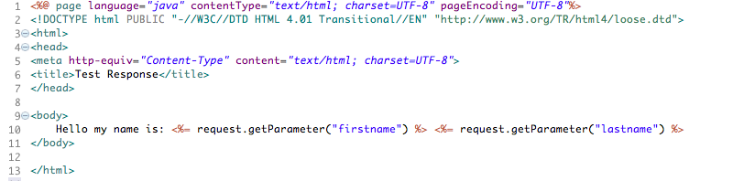
Can I see an example JavaServer Page?
Request Params!
hostname:port/appname/TestResponse.jsp?firstname=Mark&lastname=Reha
Java Code
Data passed to JSP via HTTP GET parameters and uses the implicit request object.
Standard HTML Tags
Java Code is indicated by opening and closing <% tags, the <%= renders data. Uses implicit request object.
How does a JSP generate dynamic web pages?

Slide 25
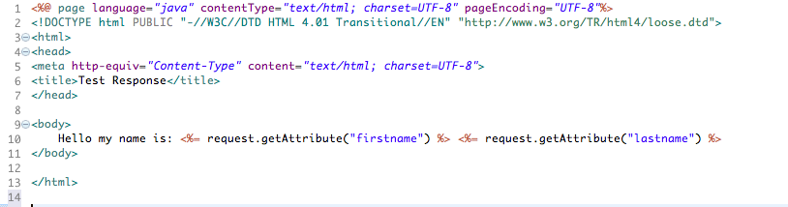
Can I see an example JavaServer Page?
No Request Params!
hostname:port/appname/TestResponse.jsp
Java Code
Standard HTML Tags
Java Code is indicated by opening and closing <% tags, the <%= renders data. Uses getAttribute()!
Data passed to JSP via Servlet Attributes.
How is passing data via Servlet Attributes more secure?

Slide 26
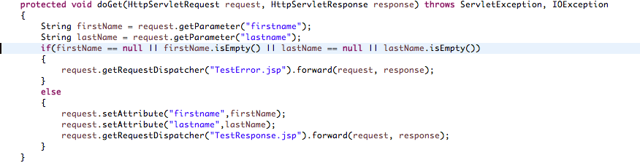
Can I see an example Java Servlet and JSP?
Request Params!
hostname:port/appname/TestServlet?firstname=Mark&lastname=Reha
Read params
Forward request to a JSP and pass it data
Remember this all happens on the Server and in Java Code!!
JSP => View for presenting data only
Servlet => Processing Client events/requests and forward to View to display

Slide 27
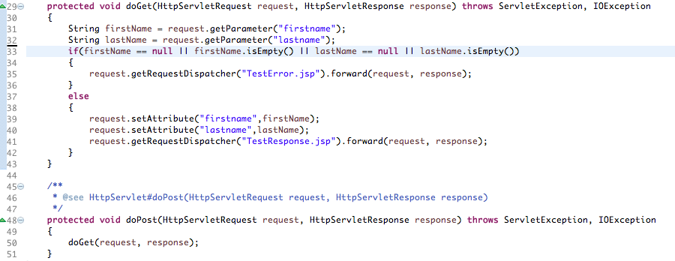
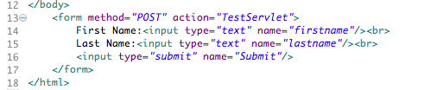
Can I see an example JSP with a Form?
hostname:port/appname/TestForm.jsp
Read params
Forward request to a JSP and pass it data
Remember HTML is all client code and Servlet code and JSP code is all server code.
How can this design be made more secure?

Slide 28
Discussion – Why JSP + Servlet?
Both JavaServer Pages and Java Servlet technologies are pretty old (almost 20 years now).
I did not spend any more time on JavaServer Pages than necessary and I could have spend many more weeks on JSP. Pure JSP has been replaced by JavaServer Faces and other MVC frameworks, which is where we will focus on moving forward.
Even Java Servlets, for the most part, have been replaced by Controllers in all MVC frameworks although they are used by the MVC frameworks.
I wanted to give you some foundation as these technologies formed the core for new frameworks and technologies in Enterprise Java.
Where might a Java Servlet still be used in a design?

Slide 29
In-Class Activity
Code a Java Server Page!
Finish the In-Class Activity #2a that I posted in an Announcement.
Implement a JSP with a Form.
Implement a JSP for a response page.
Make a HTTP POST request to a Servlet.
Get Form + Servlet + Response working end to end.
Test in your browser.
Take screen shot.

Slide 30
Weekend Reminders
Continue to work on the sitemap, database design, and high level design of your application. Next week we get into JSF!
Submit In-Class Activity #2a Report to the Main Forum.

Slide 31
End of Class

Slide 33
Lectures for Topic 2 – Week 2
Lecture:
MVC Design Pattern.
Introduction to the JavaServer Faces Framework.
Models (Object Models / Managed Beans / View Scopes).
Controllers (and navigation).
Views (and Model Binding with Forms).
Hands On:
Create a default Dynamic Web Application with JSF enabled.
Code a simple Object Model class.
Code a simple JSF Page.
Coding a complete simple Registration Form.

Slide 34
Java Server Faces (JSF)

Slide 35
Class Discussion
Who has heard of the term Design Patterns?
What are they?
Who has heard of the MVC Design Pattern?
What is it?

Slide 36
Introduction to the MVC Design Pattern
The appropriate amount of time must be spent designing the Presentation Layer and the designer must use the appropriate design pattern(s).
The MVC design pattern is used to build the Presentation Layer.
The MVC design pattern helps (but does totally prevent) to enforce separation of concerns to help you avoid mixing presentation logic, business logic, and data access logic together.
Model View Controller Design Pattern in summary:
Model: manages the behavior and data from the application layers
View: manages the display of data
Controller: handles page events and navigation between pages (calls Business Services to get the (Object) Model and navigates to the next View)

Slide 37
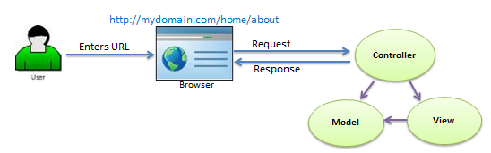
The MVC Design Pattern – Logical View
Domain of Server
App
Request URI (mapped to Controller method)
.xhtml
This ALL happens on the Server
Calls
Forward
Binding
Generally renders HTML but does not have to
Data => object model
+
Business Logic => business logic

Slide 38
The MVC Design Pattern - Component Diagram
Browser
Response (HTML)
Browser renders HTML (generally) and generates user events caused by mouse clicks or keyboard entry.
The Controller class (sometimes from a framework) handles the browser events and delegates to your Controller method.
The Controller method calls the appropriate Business Service, which returns the Domain Model to the Controller. The Business Service plus the Domain Model forms the basis for your Canonical Model.
The Controller code passes an instance of the Domain Model and then navigates to View where the View is bound to the data and rendered back to the Browser.
Notice the clean separation of the Presentation Layer and Services Layer. The Services Layer can be reused!
Client Layer
Request (POST)
Presentation Layer
Dispatch Servlet!
This ALL happens on the Server
Controller
View
Request Handler
Forward
Service
UI Logic
Invoke
Model
Data Binding
Presentation Layer
Services Layer
Object Model
This ALL happens on the Server
Business Services Model
Canonical Model

Slide 39
The MVC Design Pattern - Sequence Diagram
Controller
Model
(canonical)
View
The Controller class (which should be reusable across clients and sometimes from a framework) handles the browser events and delegates to your Controller method.
The Controller method the appropriate Business Service, which returns the Domain Model to the Controller.
The Controller copies (or has) an instance of the Domain Model and then navigates to View where the View is bound to the data and rendered back to the Browser.
Some MVC frameworks allow you to inject instances of your Model (both Presentation and Domain as well as the Service) into the Controller class.
Dispatch Servlet!
request
Dispatch
Servlet
requestHandler
Services Model
invokeService
This ALL happens on the Server
navigateView
Data Model
getProperty

Slide 40
What is JavaServer Faces?
JavaServer Faces (a.k.a. JSF) is the MVC Framework that is part of the Enterprise Java Standard.
JSF was first included in J2EE in 2006 as part of Java EE 5.
You heard correct, the Enterprise Java Standard went 8 years without an MVC Framework as part of its standard.
What did the industry use?
Continued using JSP and Servlets
Home Grown MVC Framework
Apache Struts 1.x (was the de-facto standard)

Slide 41
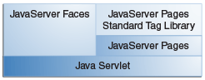
Why JSF?
One of the greatest advantages of JSF is that it offers a clean separation between behavior and presentation for web applications. This is because JSF implements the MVC design pattern!
The separation of logic from presentation enables your team to also logically divide the work up in what is generally one of the most complex layers of a Web Application.
JSF also leverages familiar component by layering this framework directly on top of the JavaServer Pages and the Servlet API yet shielding you away from all these low level programming details.
Another huge advantage of JSF is that (since it is a standard) developers can be build UI components that can be “plugged” into your application and JSF components don’t have to necessary render HTML.
Checkout Apache Tomahawk and Apache RichFaces for JSF Component Libraries!!

Slide 42
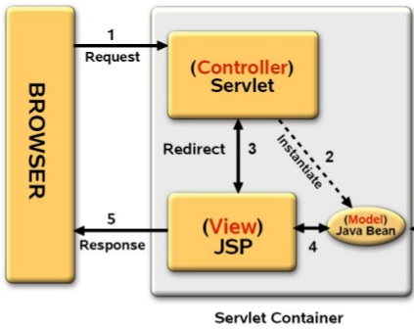
What is required to build JSF Pages?
Model: These components are made up of object or domain models, which are POJO’s that hold your business data, and Business Services that execute your business logic and business rules.
View: These components are made up of JSF Pages. This is similar to building HTML pages but you use JSF Tags. The View should ONLY render your data and send requests to the server.
Controller: These components are Java Classes that are configured to handle requests made by your Views. Controllers (and their methods) are called as part of a JSF component actions parameters. The Controller invokes your Business Services (i.e. Model), return Object Model data to bind to the View, and finally handle navigation between your Views.
Managed Bean
JSF Page
Managed Bean
and Java EJB
Almost all MVC Frameworks including JSF do not totally prevent you from putting business logic etc. in the wrong layer.
There are also some one time, yet simple configuration, you must complete for your application.

Slide 43
What are some of Mark’s Recommendations?
Some examples in books (and from Sun/Oracle) intermingle “Controllers” and Object Models into a single class. I DO NOT follow these examples.
This is simply a bad practice and violates the clear separate of duties between a Controller and the Model Data.
I recommend you create separate classes for your Controller and Object Model.
You can then reuse your Object Model classes and pass these between your Layers are necessary without passing Presentation Layer tech to the wrong layer.
JSF Pages by design are XHTML, which means they must conform to strict XML syntax. The beauty of this, is that unlike JSP’s, you CANNOT put Java code (using <% %> tags) in your Views!! This keeps your Views clean (view Data, get User Input, post Request).
Controllers should be relatively simple. Handle Data Validation from posted data, call Business Services, pass the Object Model data to a View, and Navigate to the next View. If you find your Controllers are complex and becoming overly complicated your design is not correct.

Slide 44
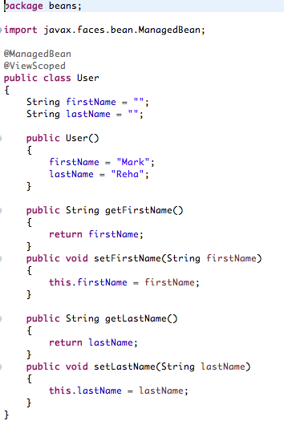
How do I Design (Object) Models?
Keep your code logically separated based on duties.
(Object) Models are nothing more than Java classes (POJO) with a number of properties in them.
Each Property represents a state/attribute (i.e. business data).
Object Models should represent real business objects (i.e. nouns).
Object Models rarely have methods other than getter and setters.
Object Models can be passed to and from the business and data access layers and are rendered in the View.
We’ll discuss this next time.
Properties.
Must have default constructor.
Use Eclipse IDE to generate!
A POJO!!
Is simply the data to be displayed by your View!

Slide 45
In-Class Activity
Create Simple Model and JSF Page
See the In-Class Activity #2b that I posted in an Announcement.
Create a Dynamic Web Application.
Enable JSF (i.e. also called a Facet in Eclipse).
Create an Object Model class.

Slide 46
End of Class

Slide 47
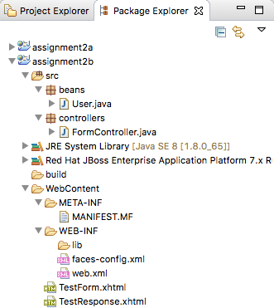
How is a Dynamic Web Project Laid Out?
All Java code separated logically by packages.
STANDARD directory were web configuration and JSF pages go.
JSF Configuration.
Web App Configuration.

Slide 48
What are Managed Beans?
Managed Beans are Java classes that are managed by the JSF framework.
An Object Model (and Controller) class is one example of a Managed Bean.
This means that you generally do not instantiate the classes directly nor destroy these classes directly. Their lifecycle is managed and controlled by the JSF framework.
You use annotations to decorate your code versus writing lots of configuration in XML files.
Use the @ManagedBean annotation!
Mark this class to be managed by JSF.

Slide 49
What are Bean Scopes?
Scopes control and define the lifecycle for a Manage Bean.
This simply defines “how long” the Managed Bean will be available for use by the JSF framework.
You use annotations to control the Scope:
@RequestScoped - Bean lives as long as the HTTP request-response lives.
@ViewScoped - Bean lives as long as the user is interacting with the same JSF view in the browser window/tab.
@SessionScoped - Bean lives as long as the HTTP session lives.
@ApplicationScoped - Bean lives as long as the web application lives.
“Alive” as long as an active View is using this Bean.

Slide 50
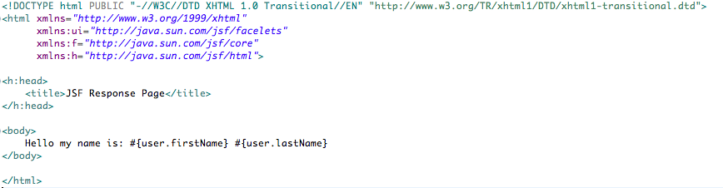
What is a JSF Page?
JSF Pages are much like regular HTML pages with the following exceptions:
They have xhtml extensions meaning they must conform to the XHTML DTD.
They use JSF tags in place of all standard HTML controls although in the end JSF tags by default all render HTML tags.
And unlike JSP’s you CANNOT write Java code in your markup (and that is good)!.
XHTML
Only a few HTML tags
Should include these tag libraries. Notice the namespaces!
A Tag library is a collection of defined tags that are “imported” for use in your page. Tag libraries are put in a namespace which is then used as prefix and colon along with the tag name.

Slide 51
How do I bind Model Data to a View?
Binding a Managed Bean’s properties (Object Model Data) to a View is done with the JSF Expression Language (EL) syntax: #{beanName.property}
JSF looks for a bean in the scope of the page that requested to use the bean. If you do not give the Managed Bean another name it simply looks for a class by that name.
Remember, this is all being executed on the Server AND NOT the Client. The JSF framework is dynamically building HTML pages using Server-Side technology.
Binding 2 properties from the User Managed Bean.

Slide 52
In-Class Activity
Create Simple Model and JSF Page
See the In-Class Activity #2b that I posted in an Announcement.
Create a JSF Page (and configure JSF to handle requests).
Request a JSF Page and bind/render Model Data to it.

Slide 53
End of Class

Slide 54
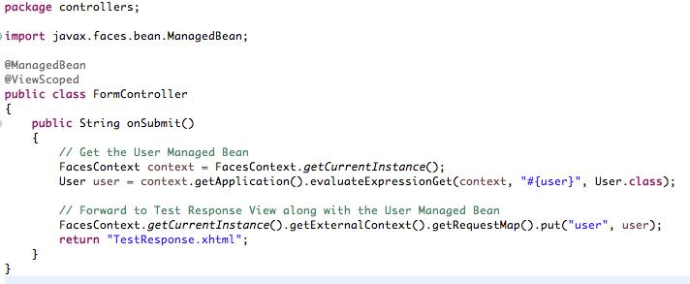
What are Controllers?
Controllers are nothing more than POJO classes with a number of methods in them to handle various requests. JSF does NOT have an explicit “Controller” class and refers to this as Managed Bean.
A Controller is a Managed Bean meaning its lifecycles is controlled by Scopes and JSF and has methods in them that can be invoked from JSF Page requests (or what JSF calls actions).
Remember to keep your Controller Managed Beans separated from your Model Managed Beans.
A Controller method is called by defining the action attribute is some of the JSF components.
Keep your code logically separated.
Managed Bean in View Scope.
A POJO!!
Controller Method.
1. Get Post Model.
2. Call Business Service.
3. Pass Model to View.
4. Navigate to next View.

Slide 55
How do I do navigation in the Controller?
Controllers should navigate to the next View once they are done processing a request.
Controller methods should return a String value that is the name of the next View.
You can pass Model Data to the View by using some JSF Context classes.
String Return Type.
Put Model in Request.
Navigate to next View.

Slide 56
What logic should I code in the Controller?
Controllers should be pretty simple.
If you have lots of code in your Controller you should think about your design again.
If you find your Controllers are complex and becoming overly complicated your design is not correct.
Controllers in general should perform the following:
Get the Posted Object Model Data from the JSF Context.
Call the appropriate Model Business Services.
Populate the Object Model Data to a View Request.
Navigate to the next View

Slide 57
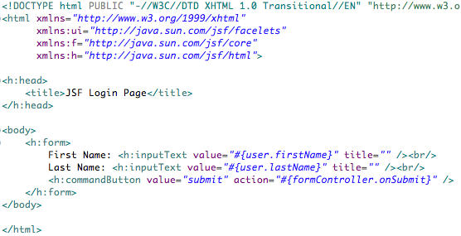
How do I handle Forms in JSF?
JSF Forms are very similar to HTML Forms exception they are built using JSF Tags.
JSF Form Tags render into equivalent HTML Tags.
You bind data to and from the JSF Form Tags using the JSF Expression Language syntax.
The Command Button JSF Tag, along with its action attribute, can be used to POST the form to a Controller’s Method.
Text Input Control
Model Binding
Controller Method
Submit Button

Slide 58
How does all this work together?
Managed Bean
JSF Page
Managed Bean
and Java EJB
Let’s pull up the example Registration Module and walk thru the code?

Slide 59
In-Class Activity
Create Simple Model and JSF Page
See the In-Class Activity #2b that I posted in an Announcement.
Create Controller.
Create Login Page.
Wire up end to end.

Slide 60
Weekend Reminders
Finish the design and start coding the Login and Registration Pages.
Submit In-Class Activity #2b Report in Main Forum.

Slide 61
End of Class

Slide 63
Lectures for Topic 2 – Week 3
Lectures:
JSF HTML Tag Library.
Java Standard Template Library (JSTL) and JSF Expression Language (EL).
Data Validation and Layouts (Facelets).
Hands On:
Getting to know JSF HTML Tag Library and JSTL.
Build a simple JSF based application.
Add Data Validation to the Registration Form.
Add Layouts to the Registration Form.

Slide 64
What are all these JSF HTML Tags?
When you build JSF Pages most of the HTML tags have been replaced with an equivalent JSF tag.
The JSF tags are generally pretty similar to their equivalent HTML tag but add support for data binding, AJAX, etc.
Remember JSF DOES NOT have to render HTML so these tags are “wrapper” classes over what they ultimately render. That is pretty cool!
One of the better resources to learn Enterprise Java is from the Oracle Tutorials.
For Java EE 7 go to: https://docs.oracle.com/javaee/7/tutorial/index.html
Bookmark this tutorial!
For JSF Components drill down into Part III and Chapter 10.
Go to the Java EE 7 Tutorial. Drill into Part III Chapter 10. Let’s review some of the JSF HTML Tags!

Slide 65
How do I make dynamic code in JSF Pages?
Java EE supports the Java Standard Template Library (JSTL 1.2).
JSTL has a number of tags you can use make conditional decisions and loop over arrays, to build dynamic JSF pages.
JSTL also has quite a few tags you should PROBABLY NEVER use. These tags include interacting with a Database (sorry, not from a View).
The JSTL tags you need to know are from JSTL Core.
JSTL works in combination with Expression Language (EL) syntax.
For this topic we are going to go to a bit older version of the Java EE Tutorial.
Go to the Java EE 5 Tutorial at http://docs.oracle.com/javaee/5/tutorial/doc/bnakh.html. Let’s review some of the JSTL Core Tags!
Out of class….go to the Java EE 7 Tutorial. Drill into Part III Chapter 9 for documentation on EL!

Slide 66
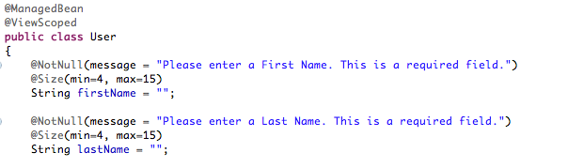
How do I do form data validation?
Java EE 7 uses the Bean Validation Standard JSR 303/349. Note these are annotations!
JSF also has a set of validation tags you can use too. Note these are tags!
The Bean Validation Standard requires you to decorate your Object Model properties using annotations to define your data validation rules.
There are a number of validators built into this standard. You can also build your own custom data validators if you have some very complex data validation rules.
You can define your own messages
Object Model Class
Bean Validation Annotations
By now you see our programming model uses lots of annotations! How does this simplify your programming?

Slide 67
Where can I get info on Bean Validation?
Again let’s simply refer to the Java EE 7 Tutorial.
For Java EE 7 go to: https://docs.oracle.com/javaee/7/tutorial/index.html
For Bean Validation drill down into Part IV.
Go to the Java EE 7 Tutorial. Drill into Part IV. Let’s review some of the validation annotations!

Slide 68
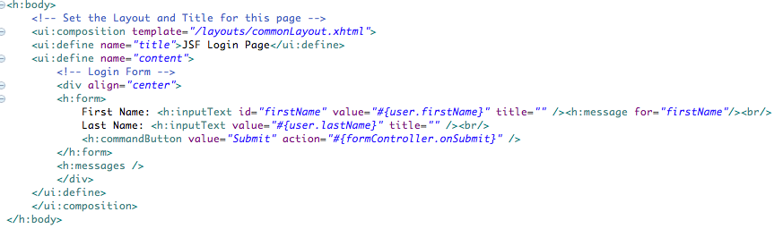
How do I display validation messages?
Use the <h:message for=“id”/> tag to display message for a form field.
Use the <h:messages /> tag to display all messages.
Field message
All messages
Go to the Java EE 7 Tutorial. Drill into Part III Chapter 10. These JSF HTML Tags are documented here!

Slide 69
In-Class Activity
Data Validation
See the In-Class Activity #2c (Part 1) that I posted in an Announcement.
Add Bean Validation rules to the Object Model class.
Add Validation Messages to the View.
Refer to the Part IV of Java EE 7 Tutorial!

Slide 70
End of Class

Slide 71
What are JSF Facelets?
Facelets enable you to build reusable UI Components and Templates.
One common use of Facelets is to support Layouts, which allows you to create “page fragments” that can be used to build common partial pages that can be assembled to form a final complete HTML page.
This allows you to build common headers, footers, and menus that can be combined with your core page content to build a single HTML page.
For documentation:
Java EE 7 docs: https://docs.oracle.com/javaee/7/tutorial/index.html
For Facelets drill down into Part III and Chapter 8.4.

Slide 72
What steps are required to design Layouts in JSF?
Design a Layout View.
Design one or more reusable Page Fragments.
Design each of your JSF Pages to use the Layout.
2. Header
1. Template
2. Content
2. Footer

Slide 73
Step 1: Design a Layout
A Layout will generate a complete HTML page!
Notice name reference
Insert content
Insert content
Insert content
Go to the Java EE 7 Tutorial. Drill into Part III Chapter 8.4. Study the Facelets Tags in the chapter!

Slide 74
Step 2: Design Reusable Page Fragments
All content outside of composition tag is ignored
Header
Footer
Go to the Java EE 7 Tutorial. Drill into Part III Chapter 8.4. Study the Facelets Tags in the chapter!

Slide 75
Step 3: Design your JSF Pages
Use defined template with all content outside of this tag being ignored.
Insert this into the logical “title” section in the template.
Insert this into the logical “content” section in the template.
Go to the Java EE 7 Tutorial. Drill into Part III Chapter 8.4. Study the Facelets Tags in the chapter!

Slide 76
In-Class Activity
Layouts
See the In-Class Activity #2c (Part 2) that I posted in an Announcement.
Use Layouts for all Pages.
Go to the Java EE 7 Tutorial. Drill into Part III Chapter 8.4. Study the Facelets Tags in the chapter!

Slide 77
End of Class

Slide 78
In-Class Activity
Catch Up
Complete In-Class Activity #2c (Part 1 and Part 2).
Work on your Project.

Slide 79
Weekend Reminders
Finish the design and start coding the Login and Registration Pages.
Submit In-Class Activity #2c Report in Main Forum.

Slide 80
End of Class

Slide 81
Lectures for Topic 2 – Week 4
Lectures:
JSF Data Grid.
Hands On:
Build a simple JSF based application.
Displaying data using the JSF Data Grid.

Slide 82
What is a JSF Data Grid?
Allows you to easily and flexibly display data in a row/column grid format.
Sometimes this “control” is referred to a Data Table.
This “control” renders a HTML Table.
Uses a few powerful JSF Tags to style and control the layout of the grid.
Where could you use a JSF Data Grid? How about in your Project?

Slide 83
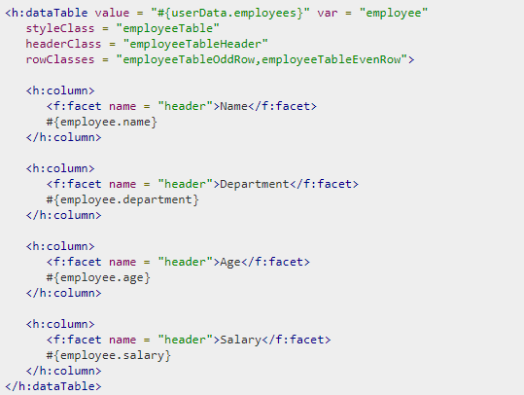
What tags are used in a JSF Data Grid?
Data Grid Control Tag
Data Grid Column Tag
Column Header and Data
In the end this simply renders a HTML table!

Slide 84
How can I style the JSF Data Grid?
CSS Classes for the Data Grid, Header, and Rows
Other Attribute
bgcolor = table bg color
border=table border color
cellpadding=cell padding
cellspacing=cell spacing
onclick=mouse click
ondblclick=mouse dbl click
onmouseover=mouse over
Play with CSS and Attributes to see the impact of your Data Grid design!

Slide 85
How can I bind a model to the JSF Data Grid?
Model UserData.
Method getEmployees().
Returns a List<type>.
Loops over the list!
Set the variable ‘employee’ in each iteration of the loop saving List Type in this variable.
Access variable ‘employee’ and bind property to Grid (calls getter method on the Model property).S

Slide 86
Can I see some example code?
Let’s walk through an example:
Object Model
JSF Data Grid Page

Slide 87
In-Class Activity
JSF Data Grid
See the In-Class Activity #2d that I posted in an Announcement.
Build an Object Model class.
Bind the Model to a JSF Data Grid.

Slide 88
End of Class

Slide 89
What are some other JSF Components?
One of the unique features of JSF is that the open source community and companies have written Component Libraries that are compatible with JSF. This enables you to add feature rich UI Components to your Pages!
Apache Tomahawk (free)
JBoss Prime Faces (free)
ICEFaces (commercial)
Some JSF Components from these sources include:
Buttons, Captcha, Calendar, Picture Carousel, Charts, Data Grid
Google Maps, Menu Bars, Tabbed Panel
Tree Controls, Credit Card Text Control, Email Text Control
and much much more…………..
Are there any controls that you could use in your CLC Project?

Slide 90
In-Class Activity
JSF Data Grid
See the In-Class Activity #2d that I posted in an Announcement.
Build an Object Model class.
Bind the Model to a JSF Data Grid.

Slide 91
End of Class

Slide 92
In-Class Activity
Catch Up
Complete In-Class Activity #2d.
Work on your Project.

Slide 93
Weekend Reminders
Submit Milestone #2 (Main, Login, and Registration Modules).
Submit In-Class Activity #2d Report in Main Forum.

Slide 94
End of Class

